Slide 1
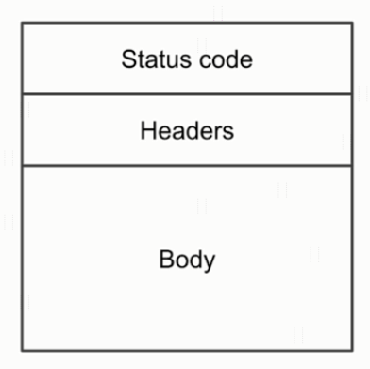
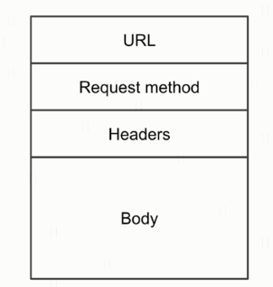
HTTP Body
HTTP Response Message
HTTP Request Message

Slide 2
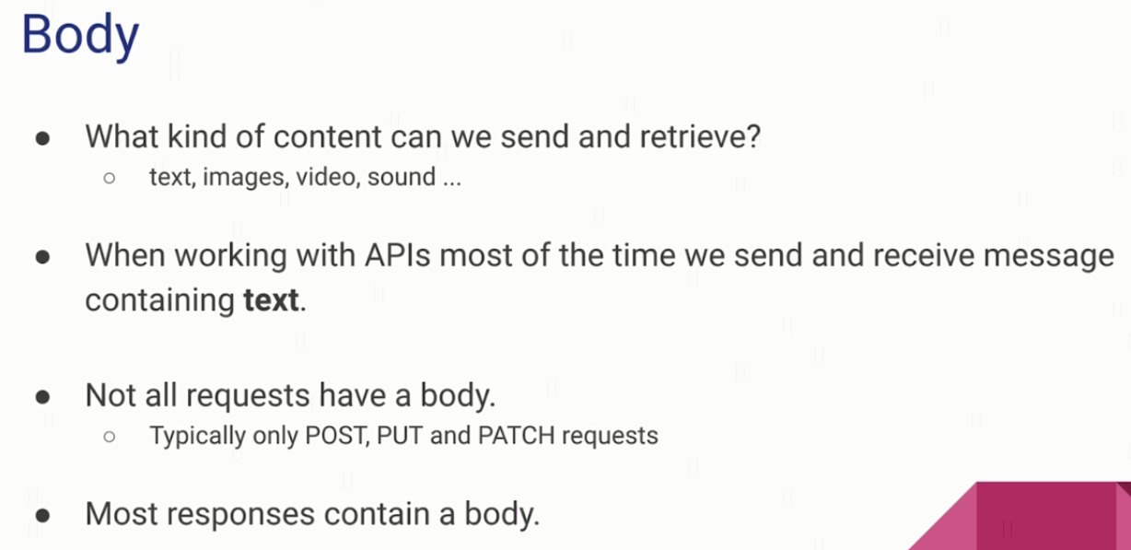
HTTP Body

Slide 3
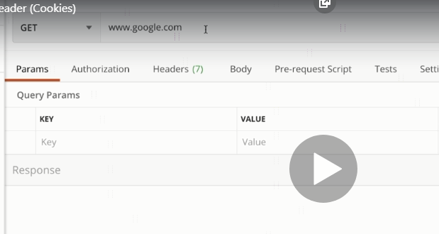
explain

Slide 4
HTTP Message Structure
https://www.udemy.com/course/introduction-to-apis-rest-api-graphql-soap-web-services-grpc/learn/lecture/19945794#overview

